Slide 1


STALEY SENIORS 2019
Student Support
Counseling Center….
College and
Career Ready!

Slide 2
WHO IS MY COUNSELOR???
James McNeely A-D
Mallory Parra E-K
Jennifer Grossman L-Re
Marilyn Charlton Rh-Z

Slide 3
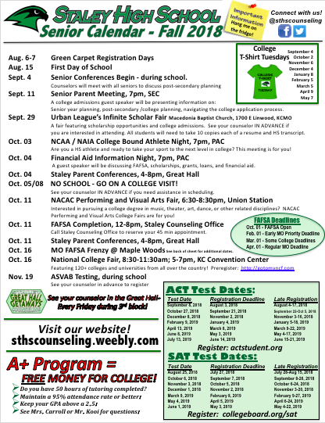
STALEY SENIORS 2019
College and
Career Ready!
Important Dates
Throughout the Senior Year!
Notes:
October 25, College Connections. 12-17 College Reps, Start in PAC, move to Great Hall for mini College Fair. Chance to meet and talk with reps about POSSIBLE scholarship money!

Slide 4
5/12/18
STALEY HIGH SCHOOL EVENTS
FAFSA HELP
Oct 4, 2018 Financial Aid Presentation 7:00-8:00 pm
Staley High School Performing Arts Center. Geared for seniors and their parents/guardians but all are welcome to attend. A guest speaker from a university financial aid office will present a program on how find money for college!
Oct 11, 2018 FAFSA One-on-One Assistance 12:00-8:00 pm
Staley High School Student Support Center (During Fall Parent-Teacher Conferences)
Contact Mrs. Lewis at 816-321-5335 to schedule your 30 minute appointment.
MCC- MAPLE WOODS
2018-19 FAFSA COMPLETION EVENTS
Oct 24 * Nov 14 * Dec 12 * Jan 30 * Feb 27 * Mar 27 * Apr 24
Maple Woods Financial Aid Office, Administration Building, Room 114
All events are scheduled for 2:00-6:00 pm
Items you need to
complete your FAFSA:
Student and parent FSA ID. To get your FSA ID: https://fsaid.ed.gov/
List of schools to which the student has applied, been accepted, or is interested in attending.
Student and parent 2017 W-2 forms and/or tax return copies. Parental information is required for most undergraduate students under the age of 24.
________________________________________________
_________________________________________________
MCC- MAPLE WOODS
2018-19 FAFSA FRENZY EVENTS
FAFSA Deadlines
Oct 1st – FAFSA Open
Feb 1st – Early MO Priority Deadline
Mar 1st – Some College Deadlines
Apr 1st – Regular MO Deadline
TUESDAY, OCT 16, 2018
Computing/Business Bldg, Room 105
2:00-6:00 pm
TUESDAY, JAN 22, 2019
Location TBA
2:00-6:00 pm
www.fafsa.ed.gov
For questions regarding Maple Woods events, please contact Robin Stimac at 816-604-3068
or robin.stimac@mcckc.edu

Slide 5
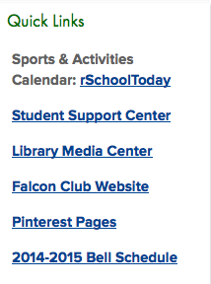
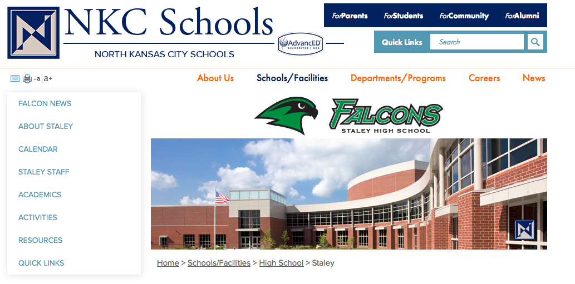
Have you visited the Staley Counseling Website?
Go to www.nkcschools.org/sths
Go to “Quick Links” and click on
“Student Support Center”
on the right side (or)
3) On left side go to “Resources” and
click on “Guidance and Counseling.”
STALEY SENIORS 2019
College and
Career Ready!
sthscounseling.weebly.com

Slide 6
STEPS IN THE COLLEGE
APPLICATION PROCESS
STALEY SENIORS 2019
Research Colleges
College Searches Staley Counseling and College/University Websites.
Links on Staley Counseling Website to popular colleges surrounding KC area and the Midwest.
Area college fairs and events.
College Representative Visits to Staley Counseling Office.
College and
Career Ready!

Slide 7
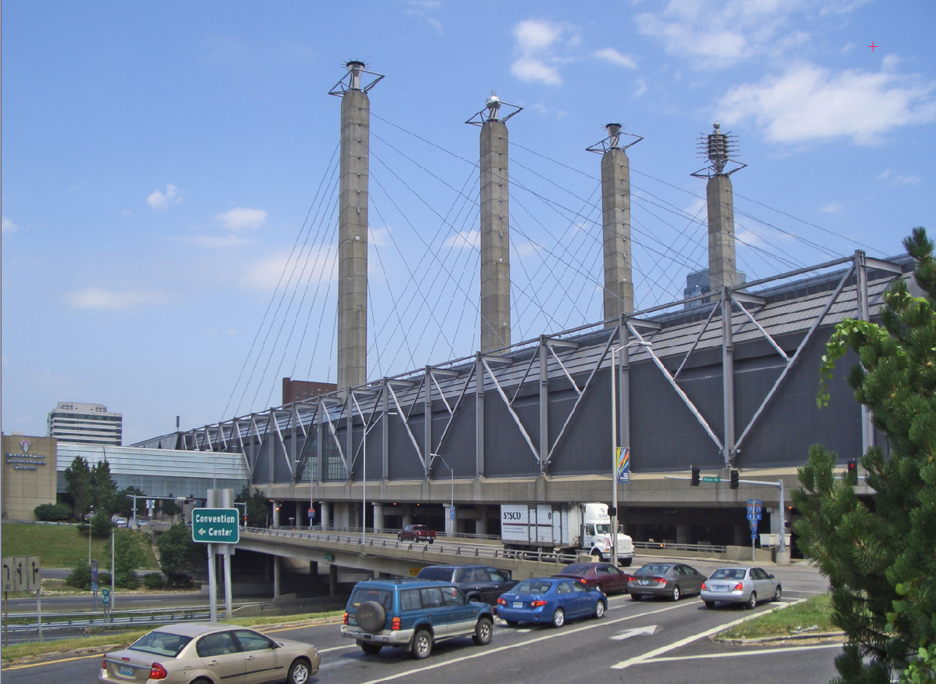
National College Fair
STALEY SENIORS 2019
Tuesday, October 16
8:30-11:30am and 5-7pm
Kansas City Convention Center
FREE! Everyone Welcome!
120+ College representatives
from all over the country.
Workshops on financial aid
and college planning!
AVOID THE CROWDS-
EVENING ATTENDANCE STRONGLY ENCOURAGED!
College and
Career Ready!
Notes:
Time Change for Evening Session

Slide 8
STEPS IN THE COLLEGE
APPLICATION PROCESS
STALEY SENIORS 2019
Visit Colleges
Schedule College Visits ahead of time.
Most will want to schedule your visit online through their admissions office website.
Take advantage of days that school is not in session.
College Visit Day Policy and Form
College and
Career Ready!

Slide 9
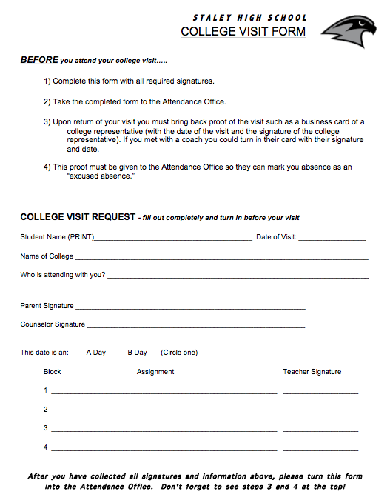
How do I go on a college visit?
Schedule your visit IN ADVANCE.
- Contact the admissions office/register online
Select dates Staley is not in session – if possible.
If during school day, see attendance for the College Visit Form – IN ADVANCE!
Fill out form completely – GET ALL SIGNATURES. Turn in to Attendance Office.
Go on your visit
2 College Visits allowed
*Count as excused absence if above steps are followed
STALEY SENIORS 2019
College and
Career Ready!

Slide 10
STEPS IN THE COLLEGE
APPLICATION PROCESS
STALEY SENIORS 2019
Take the ACT (again) or SAT
Senior Calendar: List of Test Dates and Registration Deadlines.
HAVE YOUR SCORES SENT DIRECTLY TO COLLEGES!
NCAA code is 9999
College and
Career Ready!

Slide 11
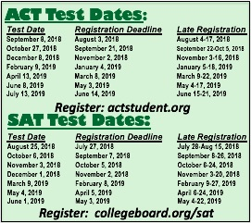
2018-2019
ACT and SAT Test Dates
STALEY SENIORS 2019
College and
Career Ready!
Be sure to register by the Regular Deadline to avoid Late Fees!

Slide 12
STEPS IN THE COLLEGE
APPLICATION PROCESS
STALEY SENIORS 2019
Fill out and Submit the College Application
Most College Applications are online and completed electronically through the college admissions website.
Most will have an application fee. Budget for these costs!
Be aware of early action and early decision deadlines—it is important to meet deadlines! *Link on Staley Counseling Website explaining “Early Action vs. Early Decision”
Students applying to selective colleges may want to use the Common Application.
College and
Career Ready!

Slide 13
STEPS IN THE COLLEGE
APPLICATION PROCESS
STALEY SENIORS 2019
Counselor Recommendation and
Letters of Recommendations
Some College Applications will require a Counselor Recommendation Form.
Give ADVANCED NOTICE for these forms to be completed (2 weeks is customary).
Complete a “Brag Sheet” to help your teachers or counselor write high quality recommendations.
College and
Career Ready!

Slide 14

Letters of Recommendation
Ask faculty and staff who know you well.
2) Ask community member(s):
  Employer or Boss
  Community service representatives
  Clubs and organization sponsors
3) Give advanced notice – ask now!
- 2 Weeks is standard etiquette
4) Complete a HS Resume or Brag Sheet to give to your letter writers.
5) Be specific as to what you are applying for when making the request.
6) Visit Student Support and counseling website for resume resources and help.
STALEY SENIORS 2019
College and
Career Ready!

Slide 15
STEPS IN THE COLLEGE
APPLICATION PROCESS
STALEY SENIORS 2019
Send your High School Transcript
Colleges and most scholarships require official transcripts to be sent directly from Staley High School.
Transcript requests should be submitted at least 5-7 days before a deadline.
Transcripts are requested with the Staley Registrar, Mrs. Long. Her office is located in Student Support. Mrs. Long cannot send transcripts without a request form!
College and
Career Ready!

Slide 16
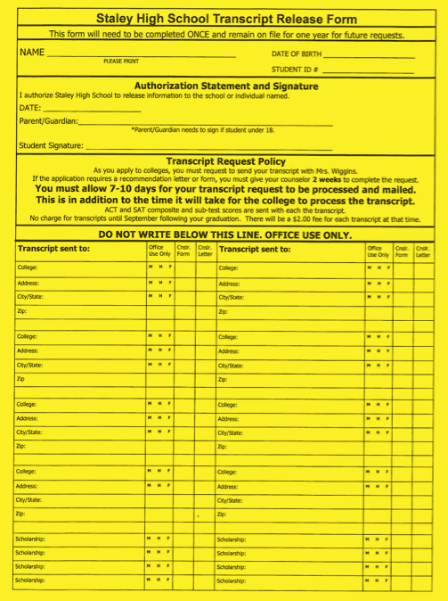
How do I have my
transcript sent to a college?
STALEY SENIORS 2019
Transcript Release Form
Important! Complete at Green Carpet Days this fall.
Complete only once! We keep on file and record where your transcripts are sent.
You fill out top part only.
Parents must sign if you are under age 18.
College and
Career Ready!

Slide 17
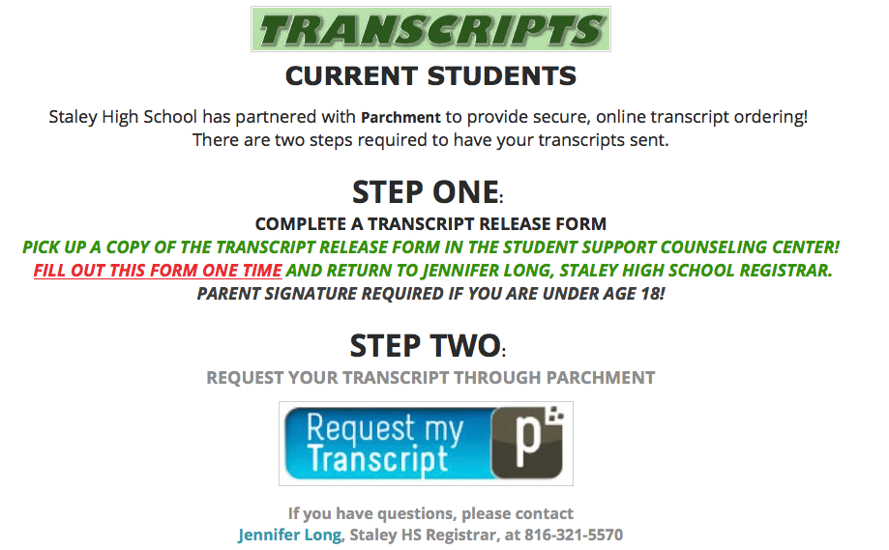
How do I have my
transcript sent to a college?
STALEY SENIORS 2019
Transcript Request Form
College and
Career Ready!

Slide 18
STEPS IN THE COLLEGE
APPLICATION PROCESS
STALEY SENIORS 2019
Find Scholarships and Financial Aid
Visit the “Paying for College” page on the Staley Counseling Website.
Become familiar with the Staley Scholarship Bulletin-check frequently throughout your senior year.
Are you participating in the A+ Program? Visit with Mrs. Carroll to monitor your eligibility and report your tutoring hours.
The Federal Financial Aid Process begins October 1st. *Attend our Financial Aid Meeting or schedule FAFSA Completion Appointment.
College and
Career Ready!
Notes:
A+ Handouts

Slide 19
FREE
Money
For College!
A+ Program
Graduate with at least a 2.5 GPA
Graduate with at least 95% Attendance
Good record of citizenship
Perform 50 hours of approved tutoring at NKC Schools
File the FAFSA
18 year old males must register with Selective Service
Achieve a Prof. or Adv. score on the Algebra I EOC or ACT Math Score of 17 or higher.
Tutoring Hours must be turned in by Friday, April 12. 2019.
QUESTIONS? See Mr. Kooi or Dena Carroll
Students are eligible to use the incentive for UP TO FOUR years after high school!!

Slide 20

Important Reminder
STALEY SENIORS 2019
If you are being recruited for to play a college sport, have you registered with the NCAA Eligibility Center?
See your counselor to make sure you have submitted your registration and have the proper courses in place.
ACT NCAA code is 9999
ATTEND THE OCTOBER 3rd “NCAA INFORMATION NIGHT”, 7pm, PAC
College and
Career Ready!

