Slide 1

STALEY SENIORS 2023
Student Support
Counseling Center….
College and
Career Ready!

Slide 2
WHO IS MY COUNSELOR???
James McNeely A-D
Mallory Parra E-K
Paige Schillig L-Re
Kevin McAdam Rh-Z

Slide 3
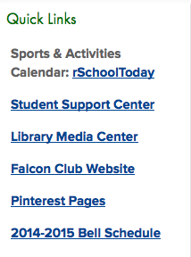
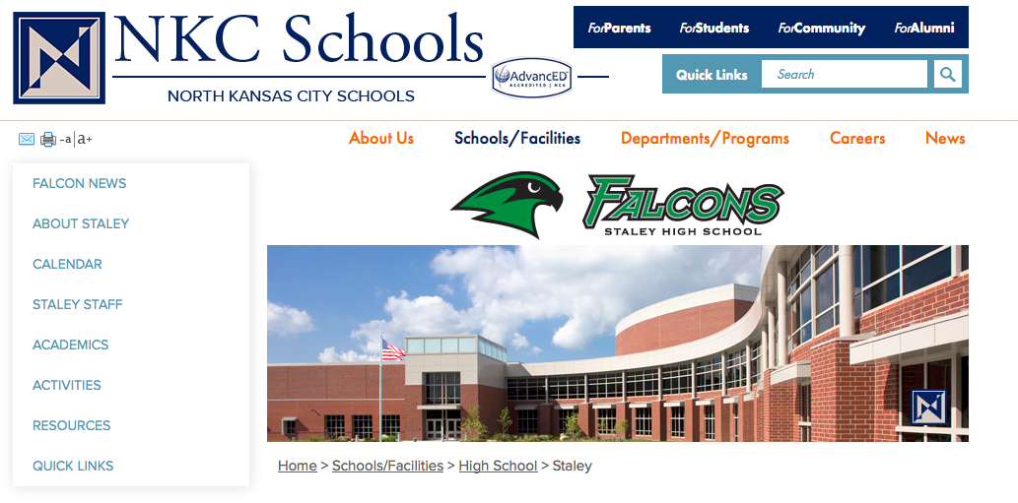
Have you visited the Staley Counseling Website?
Go to www.nkcschools.org/sths
Go to “Quick Links” and click on
“Student Support Center”
on the right side (or)
3) On left side go to “Resources” and
click on “Guidance and Counseling.”
STALEY SENIORS 2023
College and
Career Ready!
sthscounseling.weebly.com

Slide 4
STEPS IN THE COLLEGE
APPLICATION PROCESS
STALEY SENIORS 2023
Research Colleges
College Searches Staley Counseling and College/University Websites.
Links on Staley Counseling Website to popular colleges surrounding KC area and the Midwest.
Area college fairs and events.
College Representative Visits to Staley Counseling Office.
College and
Career Ready!

Slide 5
STEPS IN THE COLLEGE
APPLICATION PROCESS
STALEY SENIORS 2023
Visit Colleges
Schedule College Visits ahead of time.
Most will want to schedule your visit online through their admissions office website.
Take advantage of days that school is not in session.
College Visit Day Policy and Form
College and
Career Ready!

Slide 6
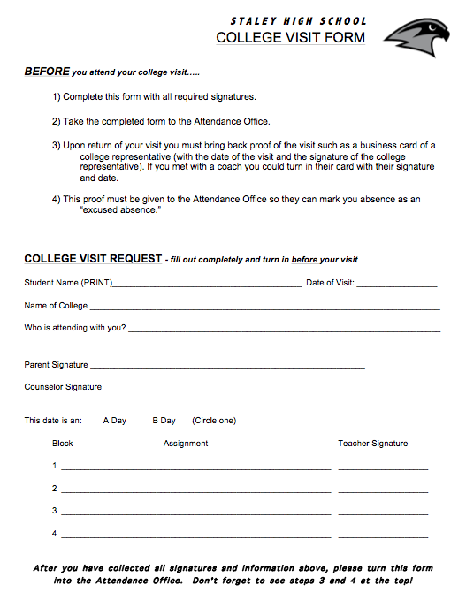
How do I go on a college visit?
Schedule your visit IN ADVANCE.
- Contact the admissions office/register online
Select dates Staley is not in session – if possible.
If during school day, see attendance for the College Visit Form – IN ADVANCE!
Fill out form completely – GET ALL SIGNATURES. Turn in to Attendance Office.
Go on your visit
2 College Visits allowed
*Count as excused absence if above steps are followed
STALEY SENIORS 2023
College and
Career Ready!

Slide 7
STEPS IN THE COLLEGE
APPLICATION PROCESS
STALEY SENIORS 2023
Take the ACT (again) or SAT
List of Test Dates and Registration Deadlines posted in Student Support.
HAVE YOUR SCORES SENT DIRECTLY TO COLLEGES!
NCAA code is 9999
College and
Career Ready!

Slide 8
STEPS IN THE COLLEGE
APPLICATION PROCESS
STALEY SENIORS 2023
Fill out and Submit the College Application
Most College Applications are online and completed electronically through the college admissions website.
Most will have an application fee. Budget for these costs!
Be aware of early action and early decision deadlines!
Students applying to selective colleges may want to use the Common Application.
College and
Career Ready!

Slide 9
STEPS IN THE COLLEGE
APPLICATION PROCESS
STALEY SENIORS 2023
Counselor Recommendation and
Letters of Recommendations
Some College Applications will require a Counselor Recommendation Form.
Give ADVANCED NOTICE for these forms to be completed (2 weeks is customary).
Complete a “Brag Sheet” to help your teachers or counselor write high quality recommendations.
College and
Career Ready!

Slide 10
STEPS IN THE COLLEGE
APPLICATION PROCESS
STALEY SENIORS 2023
Send your High School Transcript
Colleges and most scholarships require official transcripts to be sent directly from Staley High School.
Transcript requests should be submitted at least 5-7 days before a deadline.
Transcripts are requested through the student’s Parchment Account! This is the ONLY way to obtain official transcripts!
College and
Career Ready!

Slide 11
STEPS IN THE COLLEGE
APPLICATION PROCESS
STALEY SENIORS 2023
Find Scholarships and Financial Aid
Visit the “Paying for College” page on the Staley Counseling Website.
Become familiar with the Staley Scholarship Bulletin-check frequently throughout your senior year.
Are you participating in the A+ Program? Visit with Mrs. Carroll to monitor your eligibility and report your tutoring hours.
The Federal Financial Aid Process begins October 1st. *Attend our Financial Aid Meeting or schedule FAFSA Completion Appointment.
College and
Career Ready!
Notes:
A+ Handouts

Slide 12
FREE
Money
For College!
A+ Program
Graduate with at least a 2.5 GPA
Graduate with at least 95% Attendance
Good record of citizenship
Perform 50 hours of approved tutoring at NKC Schools
File the FAFSA
18 year old males must register with Selective Service
Achieve a Prof. or Adv. score on the Algebra I EOC or ACT Math Score of 17 or higher.
Tutoring Hours must be turned in by Wednesday, April 15. 2020.
QUESTIONS? See Mr. Kooi or Dena Carroll
Students are eligible to use the incentive for UP TO FOUR years after high school!!

Slide 13

Important Reminder
STALEY SENIORS 2023
If you are being recruited for to play a college sport, have you registered with the NCAA Eligibility Center?
See your counselor to make sure you have submitted your registration and have the proper courses in place.
ACT NCAA code is 9999
College and
Career Ready!

Slide 14

Seniors 2023
Questions?

